Slide 1
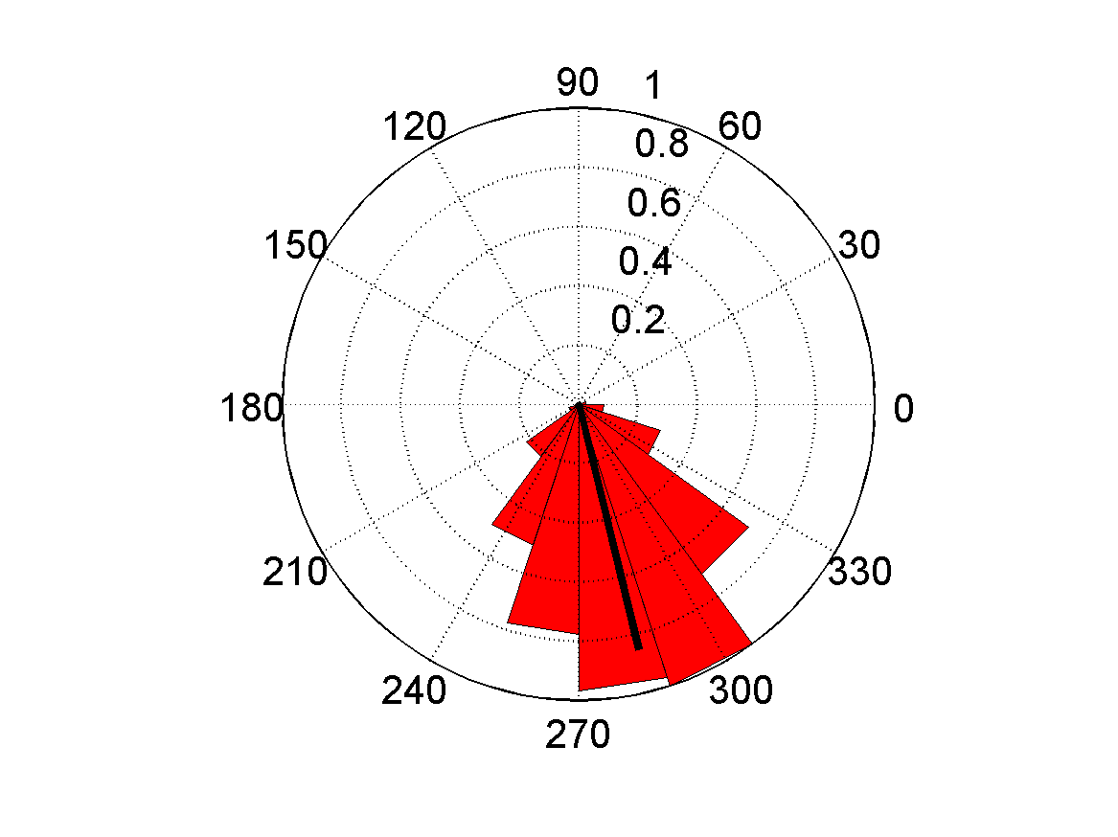
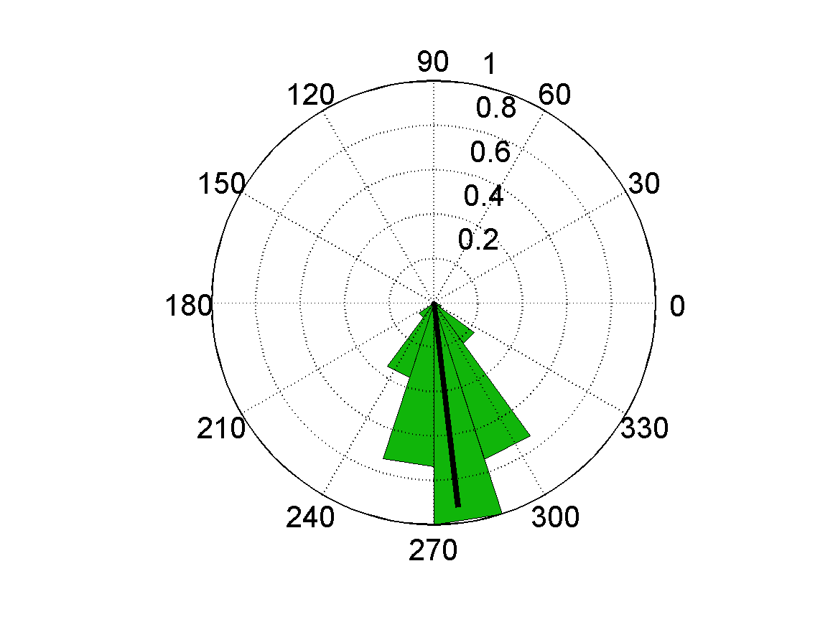
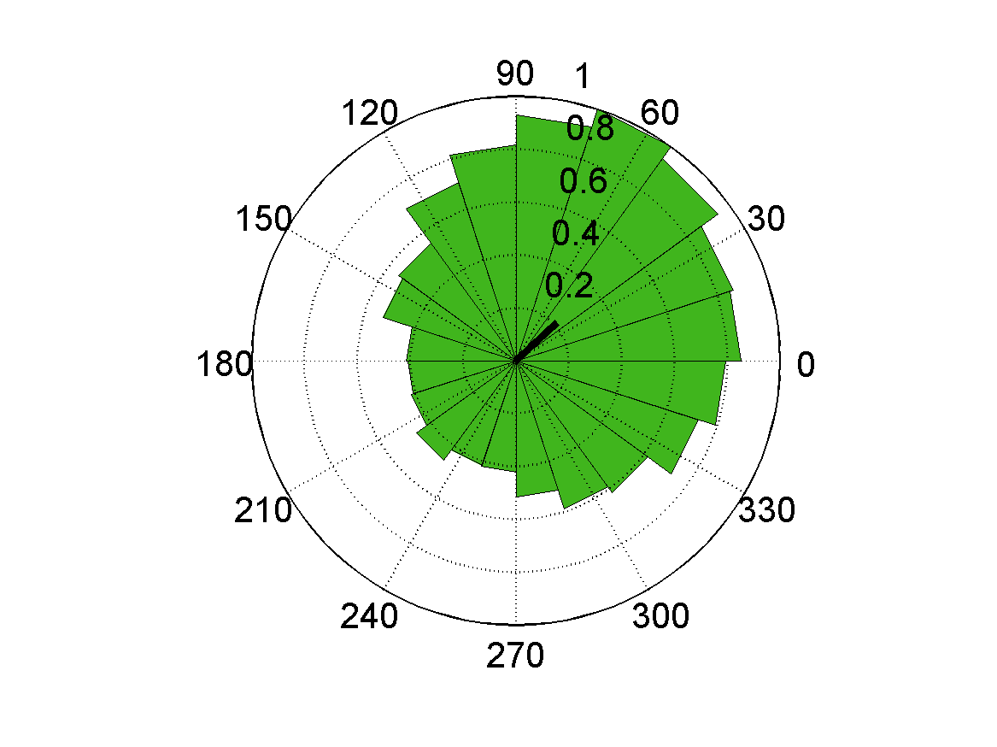
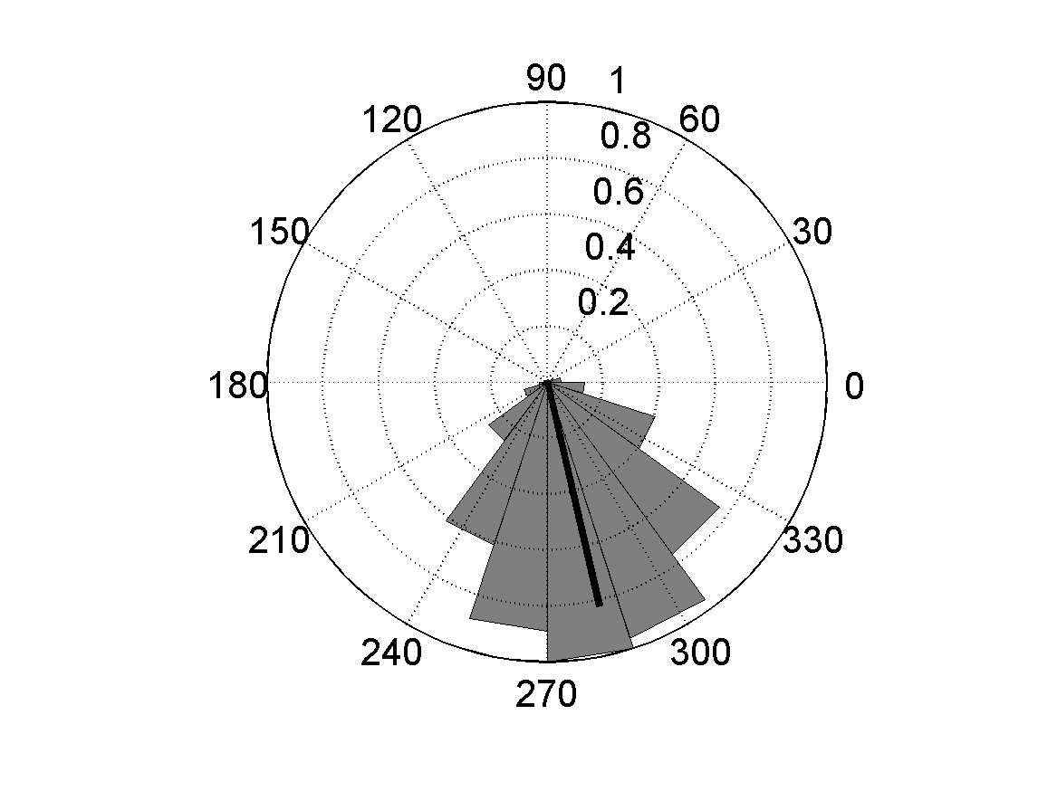
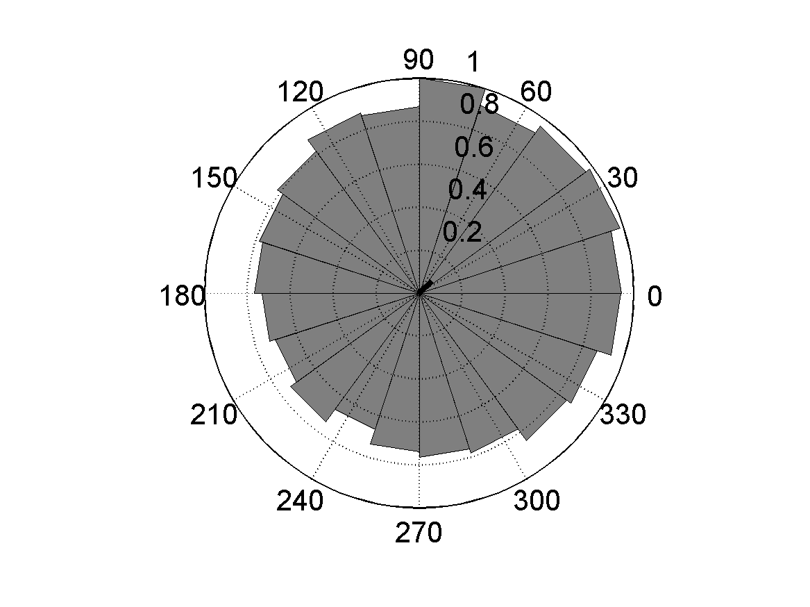
In-phase Interval
Out-of-phase Interval
IN (n = 9)
OUT-detect (n = 9)
OUT (n = 9)
Fear Conditioning
Prv-mhCHR2-eYFP
NoSTIM-IN (n = 11)
NoSTIM-OUT (n = 11)

